Slide 1
SUMMARY.
01.
Project overview
02.
Project workflow
Ts.ED
03.
Use CLI to create your application!
04.
Demo
05.
Roadmap v6
06.
Questions / Answers
Notes:
Hello everybody,
Welcome to the Ts.ED meetup. I’m Romain Lenzotti, the author of Ts.ED framework. I’m Tech Lead

Slide 2



PROJECT OVERVIEW.
Ts.ED is a backend framework for Node.js and written in TypeScript. It use annotations to declare routes, controllers, services, etc…
PHILOSOPHY
Inspired by Spring and Angular. It provides classes and annotations to simplify the application development on server-side.
FEATURES
Model
DI – Provider, Controller, Interceptors, etc…
Routing
Middlewares
Pipes
Authentication
Hooks
4
9+
…
YEARS
TECHNOS
44 CONTRIBUTORS
Developments, commits, releases, supports, features et fix.
OPEN SOURCE
TypeScript, Node.js,
Express,
JsonSchema, Swagger,
SocketIO, Mongoose, TypeORM, GraphQL,
Passport.js
8
Backers
482
Releases
~8000
Weekly downloads
Notes:
Our visite rate (23 052 since january):
USA 16.35%
Inde 8.4%
France 6.05%
Brésil 5.60%
Allemagne 5.24%
Ukraine 4.21%
UK 3.35%
Italy 3.26%
Canada 2.36%

Slide 3
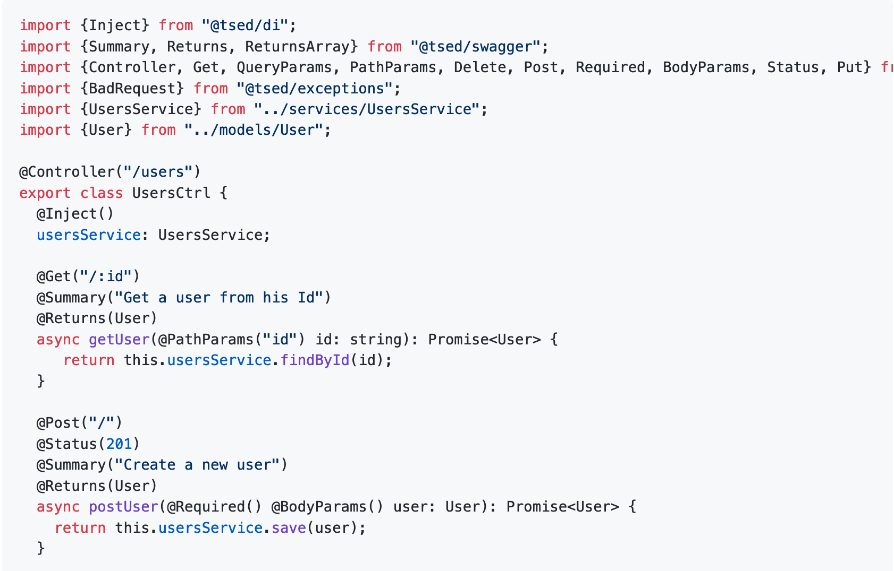
DECORATORS.
Standard proposed by Yehuda Katz.
Processus de normalisation Stage 2
https://github.com/tc39/proposal-decorators
PRINCIPES
Adding metadata to a class,
Modify classes, methods, properties and methods.
LES TYPES
ClassDecorator
MethodDecorator
PropertyDecorator
ParamDecorator
PRINCIPLE

Slide 4
PROJECT WORKFLOW.
CONVENTIONS
No release cycle
Breaking change == major version
High test coverage to prevent regression
Documentation
Document as much as possible on the website
TOOLINGS
Monorepitory management with Yarn workspace/Lerna
Version management with semantic-release
Continous deployment with Travis
Documentation with VuePress
v0
v1
v2
v3
v4
v5
June 2016
Sep 2016
Agust 2017
Dec 2017
Fev 2018
Dec 2018
DEVELOPMENT
A need > Discussions > Development et tests > Documentation > Release

Slide 5

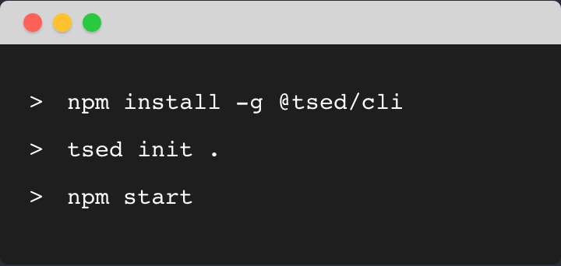
@TSED/CLI.
tsed init .
tsed generate
BOOTSTRAP PROJECT
DATABASE: TypeORM ou Mongoose
GraphQL, Passport.js, Socket.io, Swagger
Testing: Jest ou Mocha
Linter: Eslint ou TsLint, Prettier
GENERATE FILE
Provider, Controller, Pipes, …
Decorators: Class, Method, …
Ts.ED decorators
Server

Slide 6

DEMO
Ressource: https://github.com/TypedProject/meetup-tsed-publicis

Slide 7
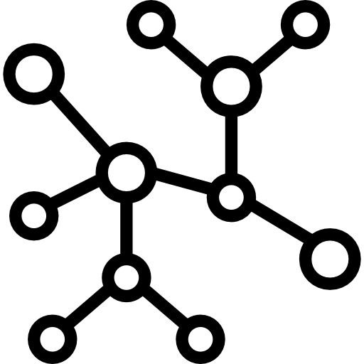


ROADMAP V6.
BREAKING CHANGES
Removal of deprecated features:
Filters
API ServerLoader
@Authenticathed replaced by @UseAuth
No more validation from ConverterService
Removal of packages:
@tsed/testing
@tsed/servestatic
@tsed/multipartfiles (?)
ts-express-decorators (module npm)
PLAFTORM API
JSONSCHEMA
OPENSPEC
Flexible and opened API
Possibility to create his own platform implementation
Koa.js / Fastify.js
New API
Adding decorators
Chainable decorators
API integrated at CORE level
Swagger 2
OpenSpec 3

Slide 8


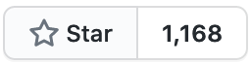

SUPPORT PROJECT.
ADD A STAR
https://github.com/TypedProject/tsed
BECOME A SPONSOR!
https://github.com/sponsors/romakita
https://opencollective.com/tsed

Slide 9

THANK YOU.
Romain Lenzotti
Consultant / Trainer
rom.lenzotti@gmail.com
romain.lenzotti@zenika.com

